Slide 1

Online Music Streaming Application
Submitted By: Rohan Khedekar (Msc.CS)

Slide 2

Content
Introduction
Objective
Requirement Specification
Methodology
References

Slide 3
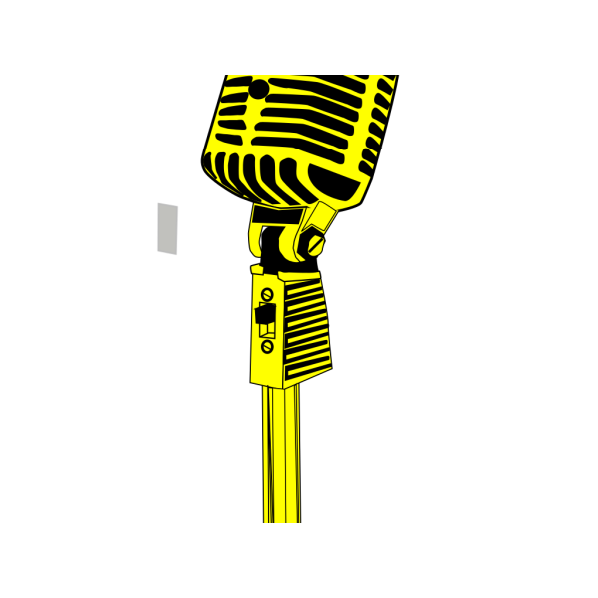
Introduction
Remember those times when the only source of music was CD collections, and if you wanted to listen to something new, you needed to buy a new CD or exchange it with your classmates? But times had changed .The emergence of Smartphone's and the ensuing digitalization had greatly affected the music industry. Now, you could listen to his favourite tracks on his phone at any time and in any place without having to buy CDs.
But you are frustrated with phone was unable to store a huge music collection. This is the right choice for that. This application is all about streaming music of different type, language, albums, artists, genres. Also application provides different advance features like you can download songs for playing offline, search songs/track/album/artist and genres that u want, different bitrates (96kbps, 160kbps, 320kbps) and the main feature was Recommendations.
This Application uses Cloud technology for Data storing and MongoDB as database management tool.

Slide 4

Objective
The main objective of the Project on Music streaming application is to play music seamlessly and get all type of music well categories. In this application music are well categories in Language, Album, Artists, Genres, and Track. Also this application provides features like user can download songs, create your own playlist and like your songs. In this application user can search songs not only search the songs also search playlist, artists and albums for better reach.
Also the main objective of this application was better reach to people. User with all type of internet connection can play the songs with smoothly for that purpose we provide songs of different bits rates with that user can play songs with poor internet connection.

Slide 5

Requirement Specification
Minimum Hardware Requirement:
RAM: 4 GB or Higher
Storage (HDD): 500 GB or Higher
Processor: Intel i3 6th Gen or Later
Minimum Software Requirement:
Operating System: Windows 10 or any
DATABASE: MongoDb
SOFTWARES:
ANDROID STUDIO: VERSION 4.1.0.0
VISUAL STUDIO CODE EDITOR
LANGUAGE: React-Native, Node.js

Slide 6

Methodology Used
Software Development Life Cycle (SDLC):
Agile:
Totally depends on an agile methodology which is iterative, an incremental method of managing the design and build activities that aim to provide new product or service development in a highly flexible and interactive manner.
What is Agile Methodology?
AGILE methodology is a practice that promotes continuous iteration of development and testing throughout the software development life cycle of the project.
Both development and testing activities are concurrent unlike the Waterfall model
Agile software development emphasizes on four core values.
Individual and team interactions over processes and tools
Working software over comprehensive documentation
Customer collaboration over contract negotiation
Responding to change over following a plan

Slide 7

Reference
https://towardsdatascience.com/how-to-build-a-simple-song-recommender-296fcbc8c85
https://theappsolutions.com/blog/development/music-app-development/
https://yalantis.com/blog/music-apps-market-experience-music-apps-development/

Slide 8

Thank You

